Slide 1
Match Puzzle

Slide 2
Done By:
  Md. Samiul Islam 011 171 160

Slide 3
Introduction
Match pair is a memory testing game which consists of 4x4 grid.
Each grid contains a single square.
Every square has a common color on one side and four different colors on the other side.
Pressing the space bar will rotate the selected square and will let the player see the color on the opposite side.
Player has to match the square of same color.

Slide 4
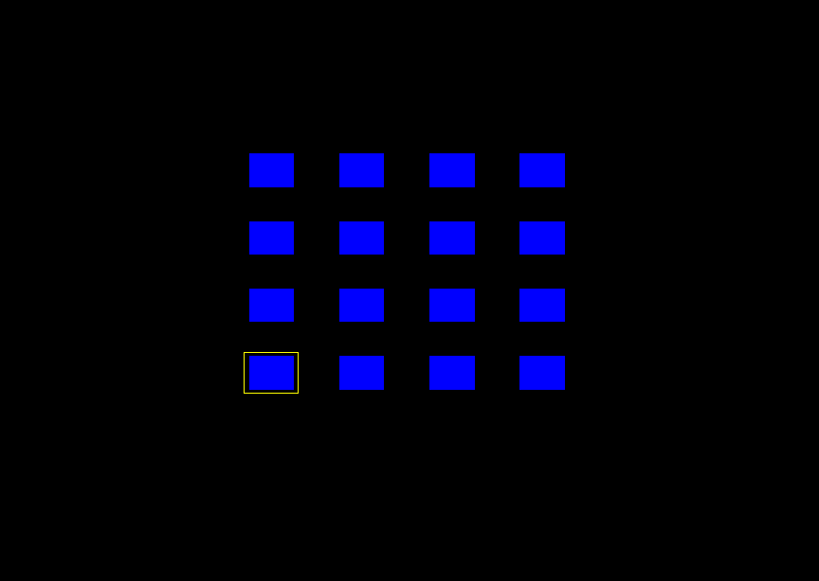
Screenshot

Slide 5
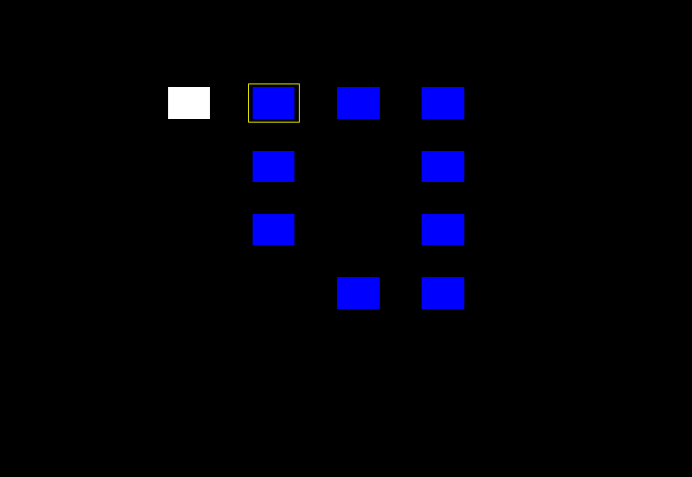

Slide 6
Thank You

